Slide 1

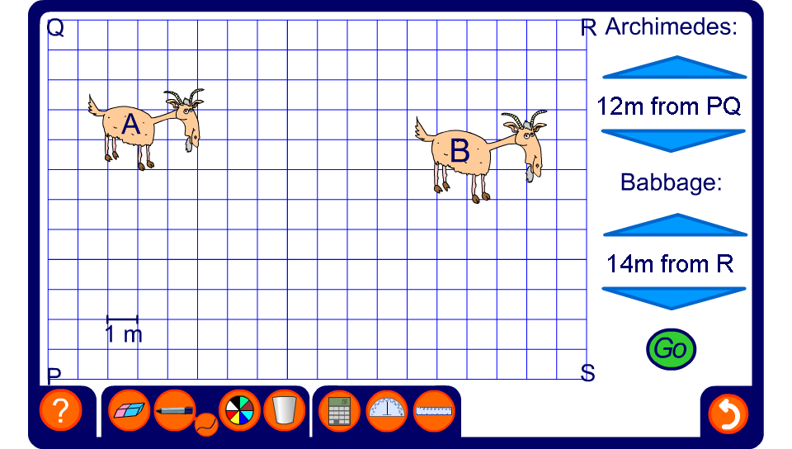


Tethered goats
Notes:
Demonstrate various combinations of grazing areas. Ask pupils how we could accurately construct the required loci using a ruler and a compass.
Ask pupils to indicate points that satisfy conditions given by the loci chosen. For example, ask pupils to indicate two points that are both 14 m from P and 14 m from R.
Investigate which combinations would give the smallest and largest overlapping areas.

